Slide 2


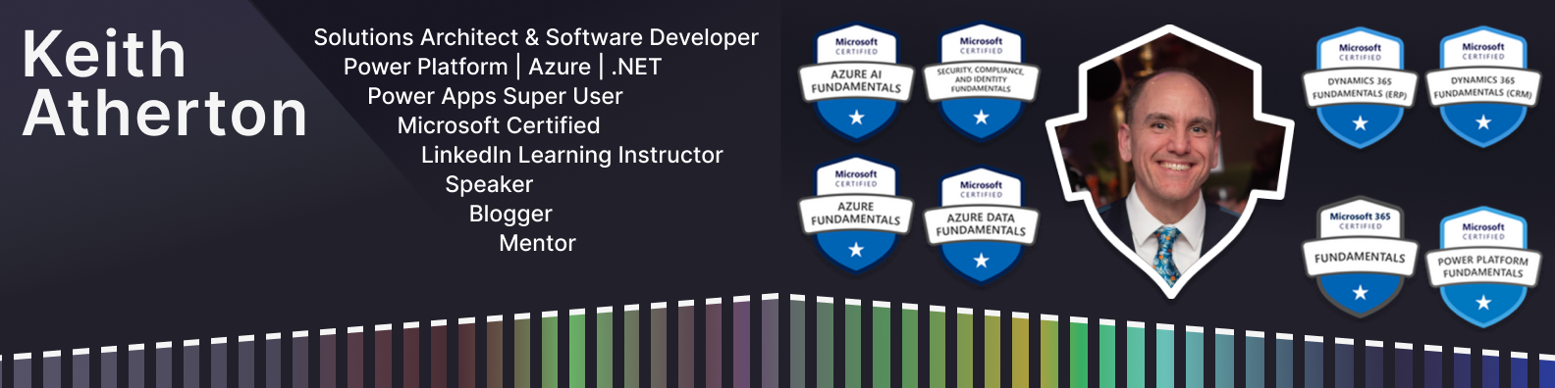

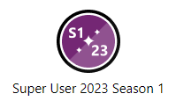
With Great Power (Apps) Comes Great Reusability

Slide 3

Topics
Benefits of reuse
User interface reuse
Code reuse
Challenges of reuse
Upcoming features
Keith Atherton | @MrKeithAtherton

Slide 4

Origin story
Keith Atherton | @MrKeithAtherton

Slide 5

Origin story
Keith Atherton | @MrKeithAtherton

Slide 6

Benefits of reuse
Keith Atherton | @MrKeithAtherton

Slide 7

Benefits of reuse
Don’t repeat yourself (DRY)
Faster development
Consistent user interface
Consistent code behaviour
Reliability of reusing tested components
Makes features available for reuse
Keith Atherton | @MrKeithAtherton

Slide 8
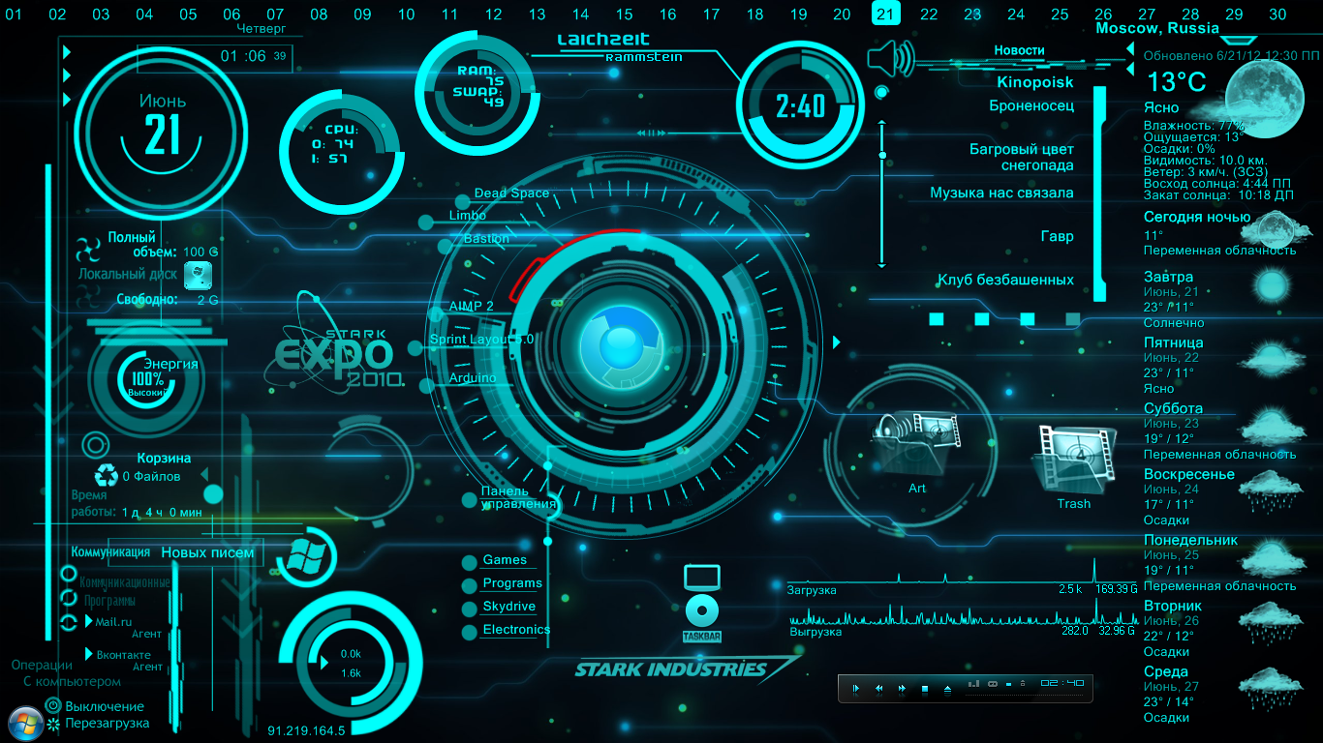
User interface reuse
Keith Atherton | @MrKeithAtherton

Slide 9
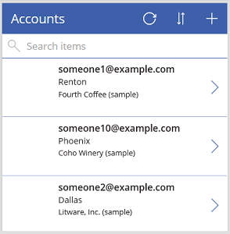
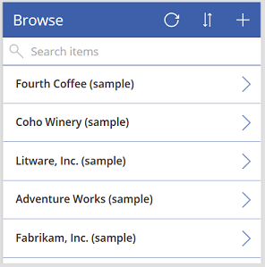
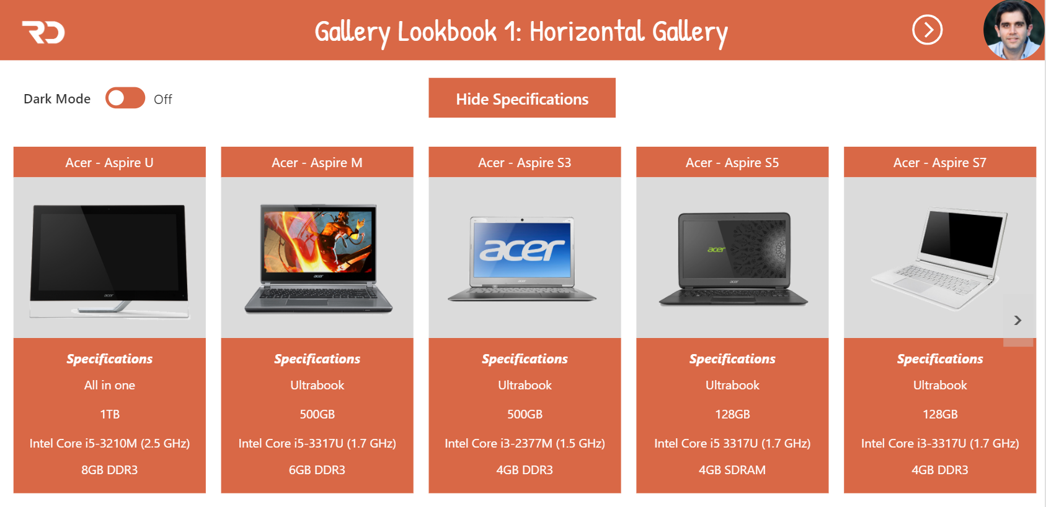
Gallery control
A control that contains other controls and shows a set of data
A Gallery control can show multiple records from a data source, and each record can contain multiple types of data
You can add one gallery inside another gallery
https://learn.microsoft.com/en-us/power-apps/maker/canvas-apps/controls/control-gallery
Keith Atherton | @MrKeithAtherton

Slide 10
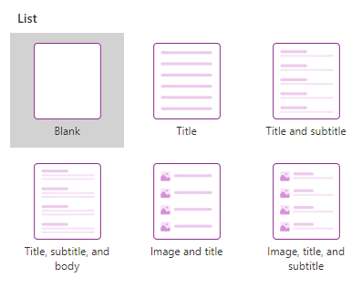
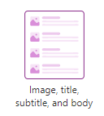
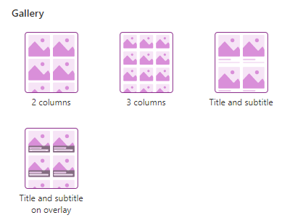
Gallery layouts
Predefined templates for showing images and text in a gallery are available
Gallery layouts have list and gallery formats
Can be a useful starting point
https://learn.microsoft.com/en-us/power-apps/maker/canvas-apps/controls/control-gallery
Keith Atherton | @MrKeithAtherton

Slide 11
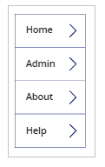
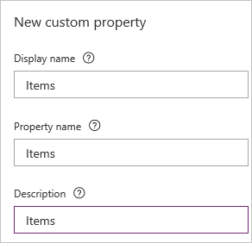
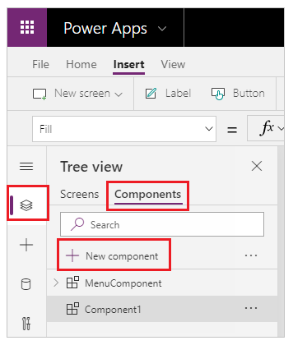
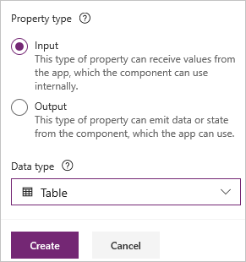
Canvas components
Components are reusable building blocks for canvas apps so that app makers can create custom controls to use inside an app, or across apps using a component library
Components can use advanced features such as custom properties and enable complex capabilities
Behavior formulas for components (experimental)
https://learn.microsoft.com/en-us/power-apps/maker/canvas-apps/create-component
Keith Atherton | @MrKeithAtherton

Slide 12
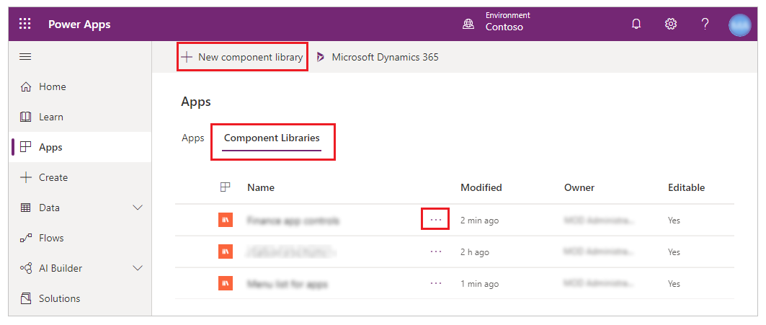
Component libraries
A library of components that can be reused
By creating a component library, app makers easily share and update one or more components with other makers
Component libraries are the recommended way to reuse components across apps
Keith Atherton | @MrKeithAtherton

Slide 13
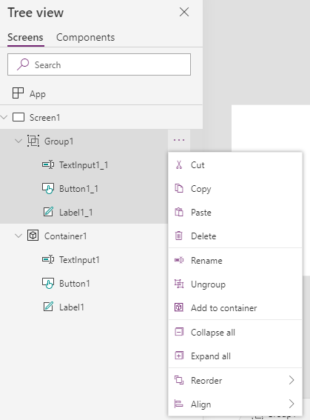
Grouping elements together
You can select controls and group them using Ctrl + G or the context menu
You can modify common properties of controls within the group
Keith Atherton | @MrKeithAtherton

Slide 14
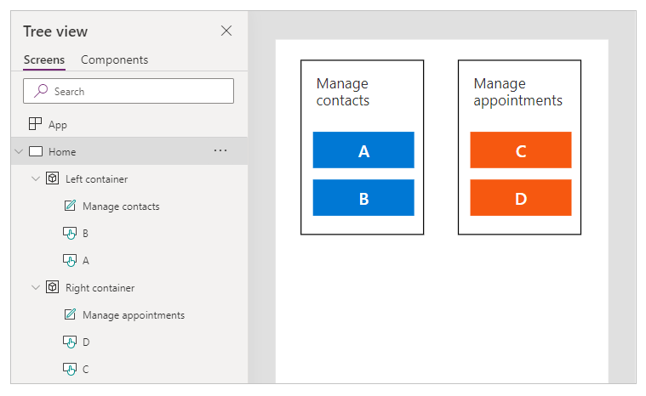
Container control
Groups logically-related controls to create hierarchies
Benefits for screen readers
A container can hold a set of controls and has its own properties
https://learn.microsoft.com/en-us/power-apps/maker/canvas-apps/controls/control-container
Keith Atherton | @MrKeithAtherton

Slide 15
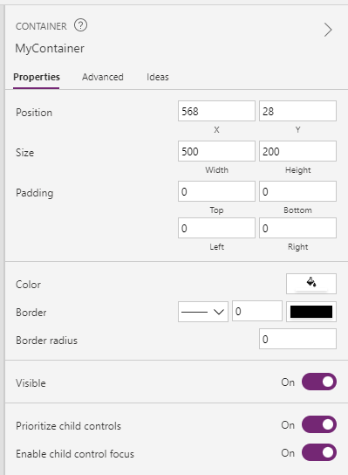
What is the difference between a container and a group?
Groups don't have properties of their own and don't affect the layout of the app
In contrast, containers are actual controls with their own properties like Width and BorderColor
Containers affect app layout and help screen reader users understand the structure of the app
https://learn.microsoft.com/en-us/power-apps/maker/canvas-apps/controls/control-container
Keith Atherton | @MrKeithAtherton

Slide 16
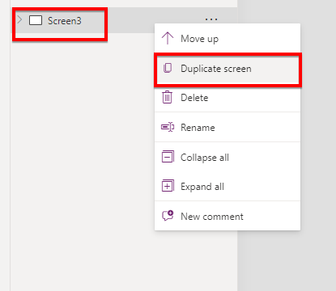
Duplication of elements
Screens and components can be duplicated
Many elements can be copied-and-pasted
Apps can be cloned using Save as
Keith Atherton | @MrKeithAtherton

Slide 17
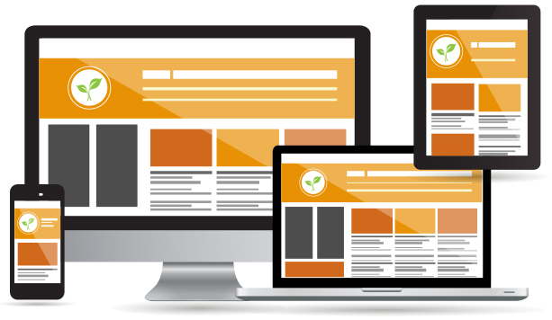
Create responsive layouts in canvas apps
Responsive web design (RWD) is about creating web pages that look good on all devices
A responsive web design will automatically adjust for different screen sizes and viewports
https://learn.microsoft.com/en-us/power-apps/maker/canvas-apps/create-responsive-layout
Keith Atherton | @MrKeithAtherton

Slide 18
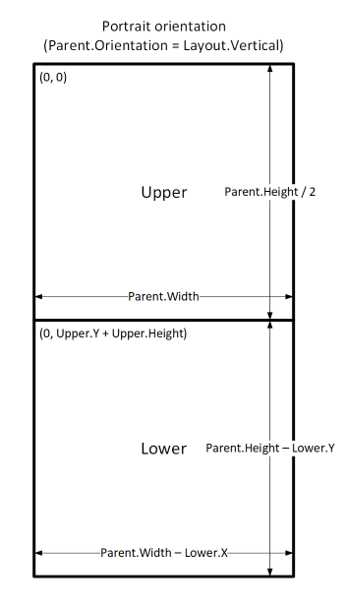
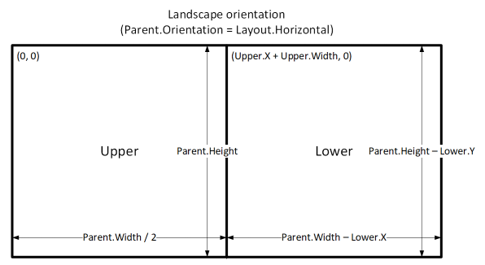
Create responsive layouts in canvas apps (continued)
If you create a responsive layout, controls can respond to different devices or window sizes, making various experiences feel more natural
To achieve responsive layout, you adjust some settings and write expressions throughout your app
Use formulas for dynamic layout
https://learn.microsoft.com/en-us/power-apps/maker/canvas-apps/create-responsive-layout
Keith Atherton | @MrKeithAtherton

Slide 19
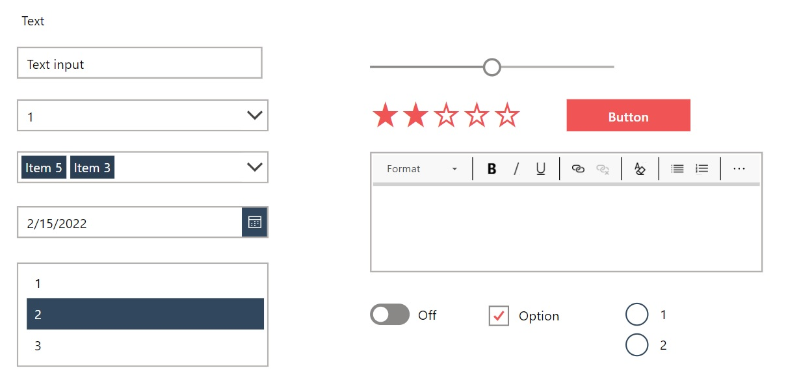
Reusing customised controls
Creating a custom theme for your app defines the unique look-and-feel of an app
Try creating customised controls and saving them to a hidden “template” screen then make copies of the controls for app screens
Sancho Harker has created a free Branding Template App to make custom themes easy
https://www.matthewdevaney.com/create-a-power-apps-custom-theme-colors-fonts-icons-controls/
Keith Atherton | @MrKeithAtherton

Slide 20

Code reuse
Keith Atherton | @MrKeithAtherton

Slide 21
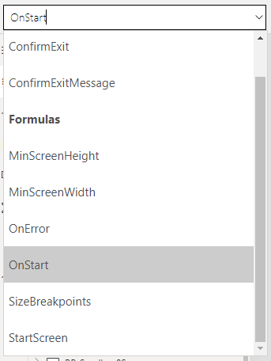
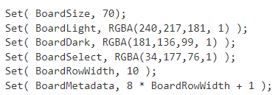
Constants
Can be placed in App.OnStart then used throughout the app
Single source of truth instead of replicated instances throughout the app
Keith Atherton | @MrKeithAtherton

Slide 22
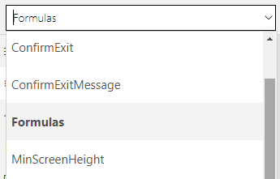
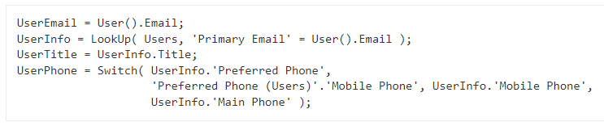
Named formulas (experimental)
Simplify your app’s initialization, reduce app load time, reuse logic, and improve the maintainability of your apps
The formula’s value is always available
The formula’s value is always up to date
The formula’s definition is immutable
The formula’s calculation can be deferred
https://powerapps.microsoft.com/en-us/blog/power-fx-introducing-named-formulas/
Keith Atherton | @MrKeithAtherton

Slide 23
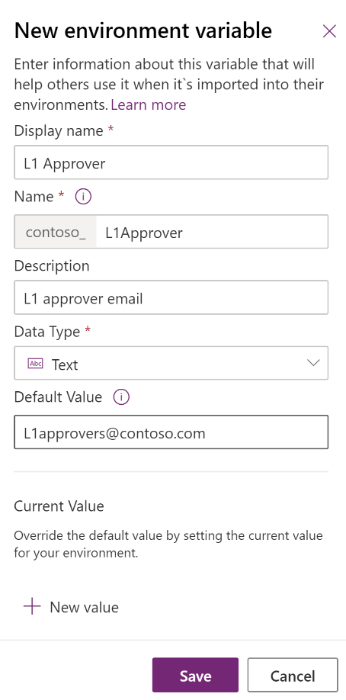
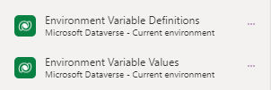
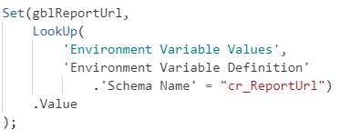
Environment variables
Environment variables store values specific to that environment
Can be used across many different Power Platform solution components such as canvas apps and flows
Environment variables allow for referencing secrets stored in Azure Key Vault (preview)
https://learn.microsoft.com/en-us/power-apps/maker/data-platform/environmentvariables
Keith Atherton | @MrKeithAtherton

Slide 24
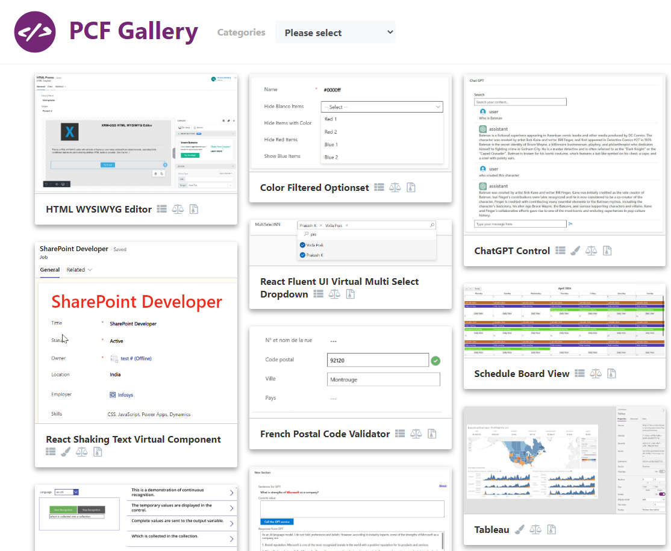
Power Apps Component Framework (PCF)
Allows you to create code components for model-driven and canvas apps
Pro-developer way of building reusable controls using HTML, Typescript, and CSS
Power Apps component framework gallery created by the Power Apps community: https://pcf.gallery/
https://learn.microsoft.com/en-us/power-apps/developer/component-framework/overview
Keith Atherton | @MrKeithAtherton

Slide 25
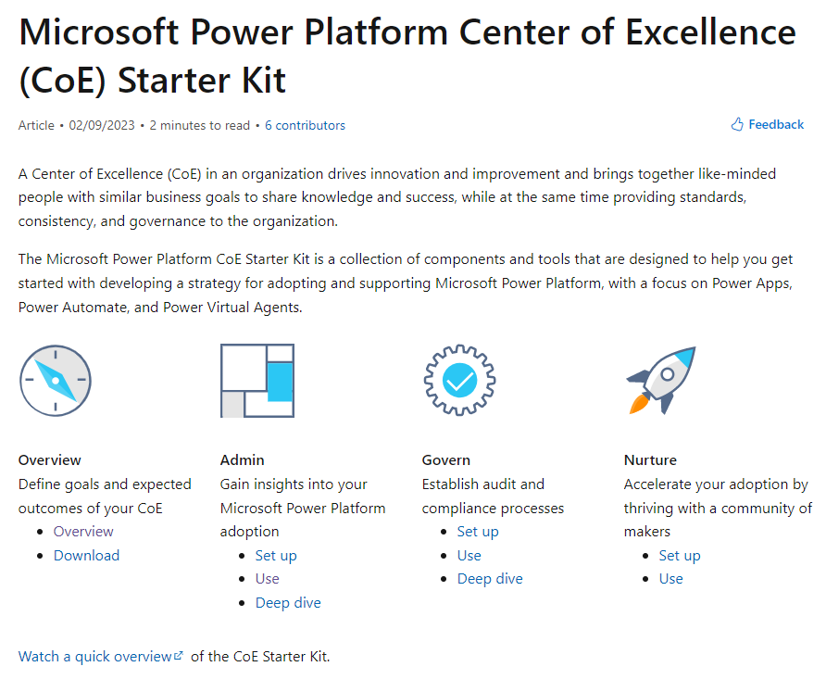
Microsoft Power Platform Center of Excellence (CoE) Starter Kit
A collection of components and tools that are designed to help you get started with developing a strategy for adopting and supporting Microsoft Power Platform
Contains many components such as theming components
Can be used as a starting point
https://learn.microsoft.com/en-us/power-platform/guidance/coe/starter-kit
Keith Atherton | @MrKeithAtherton

Slide 26

Challenges of reuse
Keith Atherton | @MrKeithAtherton

Slide 27

Challenges of reuse
Time to create reusable components up-front
Time to refactor existing components to make them reusable
Keith Atherton | @MrKeithAtherton

Slide 28

Upcoming features
Keith Atherton | @MrKeithAtherton

Slide 29
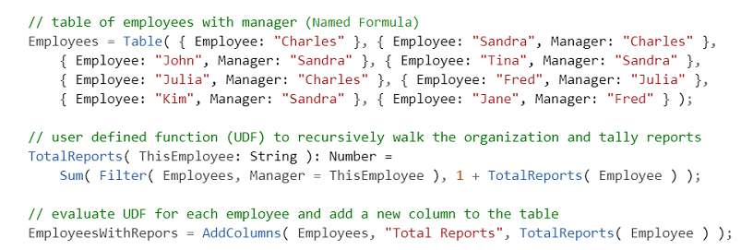
Reuse Power Fx formulas with user defined functions
Organize and reuse formulas by encapsulating logic into functions
Large formulas can be split into smaller parts, which is easier to understand, test, and reuse across an app
Functions can be recursive and can be imperative with side effects
Public Preview: Jun 2023
https://experience.dynamics.com/releaseplans/?app=Power+Apps&status=planned
Keith Atherton | @MrKeithAtherton

Slide 30
What are Preview features, and how do I enable them?
Preview features:
Are subject to separate Supplemental Terms of Use
Are not supported by Microsoft Support for production use
May have limited or restricted functionality
Aren't meant for production use
May be available only in selected geographic areas
Preview features are features that aren't complete, but are made available on a "preview" basis so customers can get early access and provide feedback.
https://learn.microsoft.com/en-us/power-platform/admin/what-are-preview-features-how-do-i-enable-them
Keith Atherton | @MrKeithAtherton

Slide 31
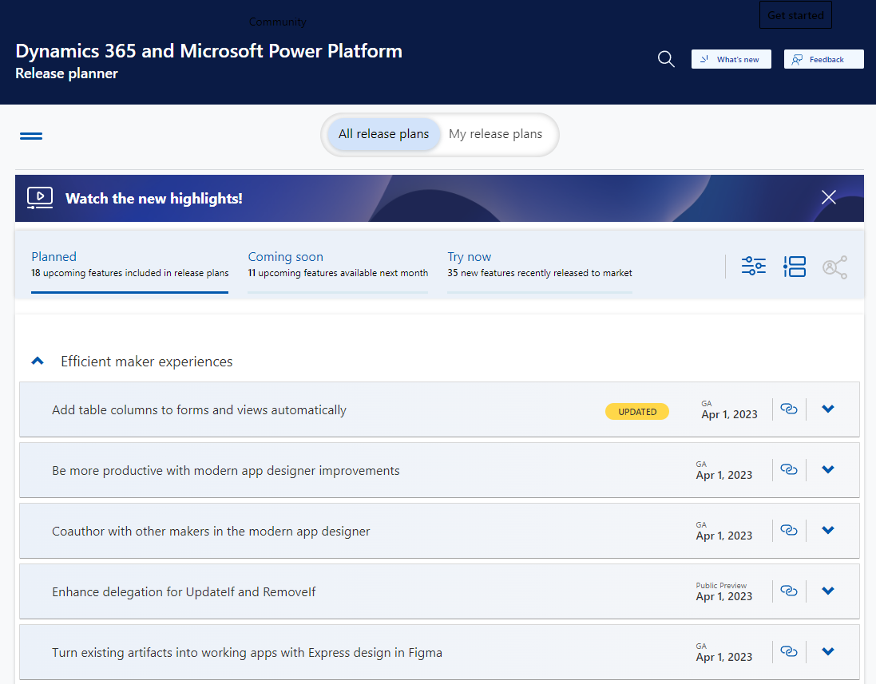
Dynamics 365 and Microsoft Power Platform – Release planner
Plan and prepare for the new and upcoming features of Microsoft Power Platform and Dynamics 365
https://experience.dynamics.com/releaseplans/?app=Power+Apps&status=planned
Keith Atherton | @MrKeithAtherton

Slide 32
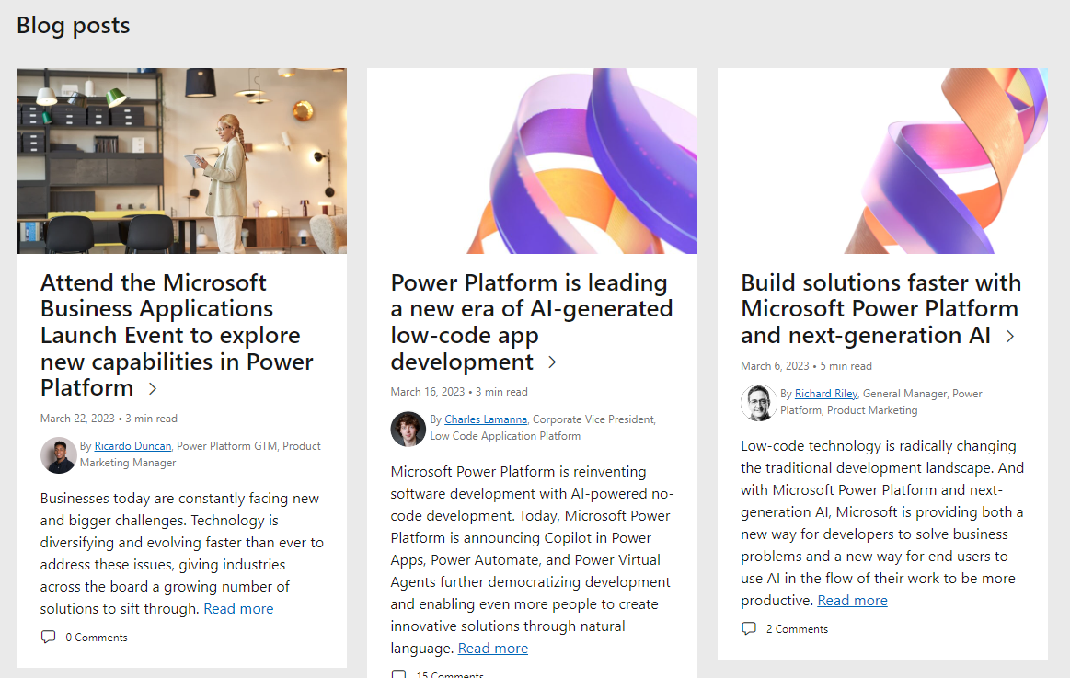
Microsoft Power Platform Blog
As well as the Microsoft Power Platform Blog, the following product blogs exist:
Power BI
Power Automate
Power Apps
Power Virtual Agents
Power Pages
https://cloudblogs.microsoft.com/powerplatform/
Keith Atherton | @MrKeithAtherton

Slide 33
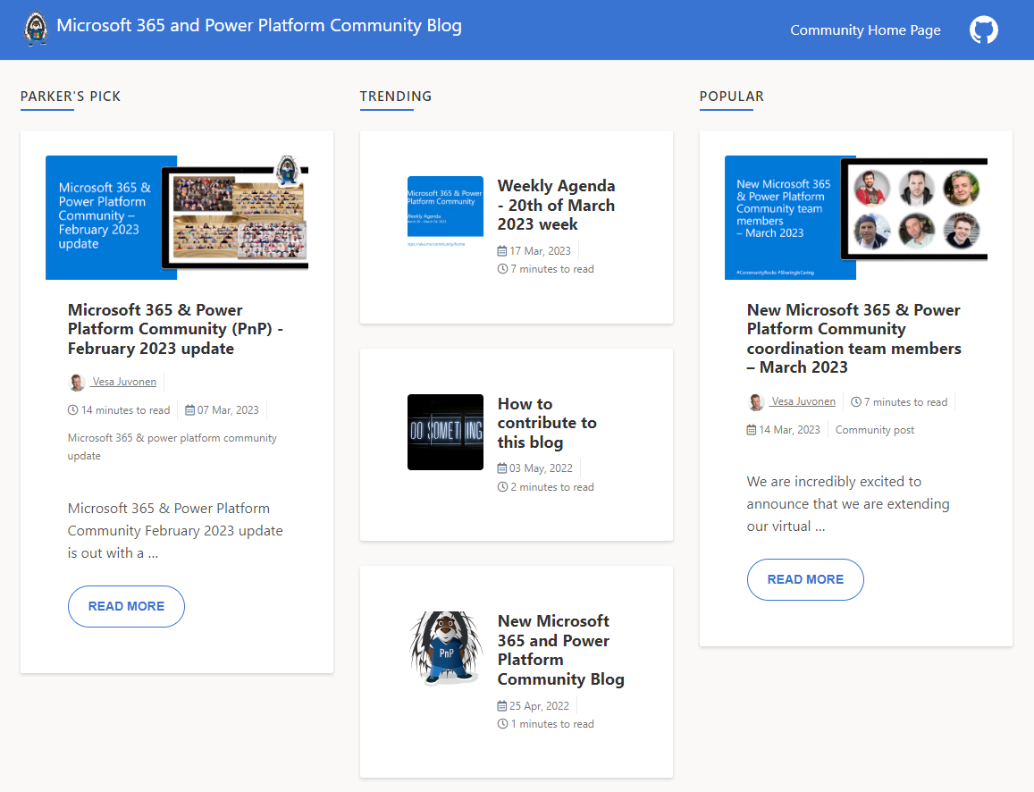
Microsoft 365 and Power Platform Community Blog
Publish articles including Community Call recording blogs, podcast blogs, monthly updates
https://pnp.github.io/blog/
Keith Atherton | @MrKeithAtherton

Slide 34
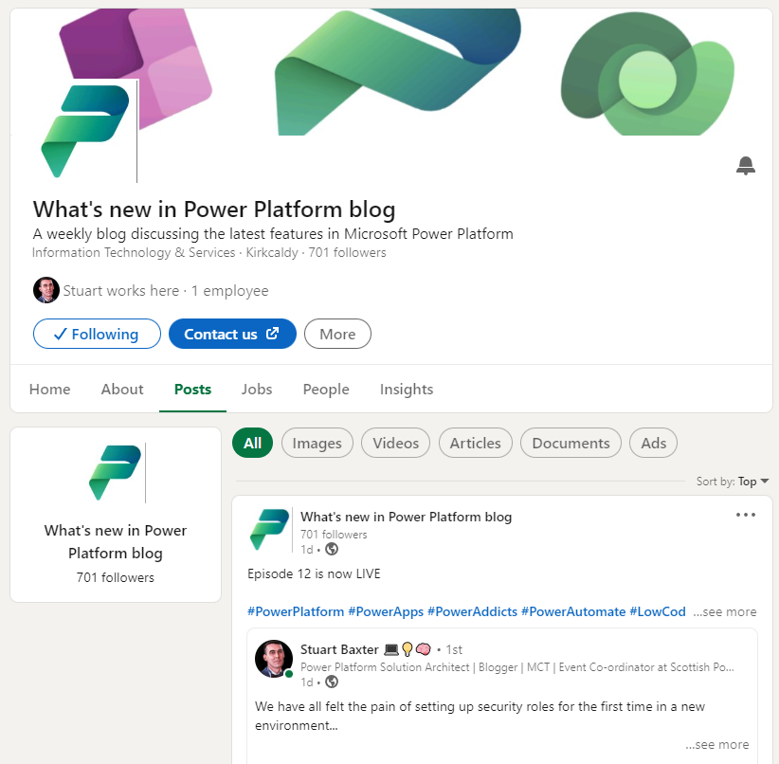
What's new in Power Platform blog
A weekly blog discussing the latest features in Microsoft Power Platform
Written by SPPUG’s own Stuart Baxter!
https://www.linkedin.com/company/whats-new-in-power-platform-blog/posts/?feedView=all
Keith Atherton | @MrKeithAtherton

Slide 35
Topics
Benefits of reuse
User interface reuse
Code reuse
Challenges of reuse
Upcoming features
Keith Atherton | @MrKeithAtherton

Slide 36
Thank you!

